Slide 1






BASH SHELL
SCRIPTING
BY ARYAN YADAV

Slide 2
UNIX SHELL
A Unix shell is a command-line interpreter that provides a user interface for Unix-like operating systems. It’s both an interactive command language and a scripting language, used by the operating system to control the execution of the system using shell scripts. Users typically interact with a Unix shell using a terminal emulator.Shells are essential for the Unix environment as they are the medium through which users can communicate with the system to perform various tasks, from simple file manipulations to complex program executions.

Slide 3
WHAT IS BASH ?
Bash, short for Bourne Again SHell, is a Unix shell and command language interpreter. It allows users to type commands in a terminal to perform operations on the system. Bash also supports scripting, which means you can write a script file with a series of commands to automate tasks.

Slide 4

APLLICATIONS OF BASH
Bash scripting is incredibly versatile and can be used for a wide range of tasks, such as automating system maintenance, processing data, managing backups etc.. By combining simple Unix commands into scripts, users can create powerful tools to handle repetitive tasks, simplify complex operations, and customize their computing environment to suit their needs.

Slide 5

A FEW IMPORTANT COMMANDS
ECHO:The echo command in Bash is used to display a line of text or variables to the terminal or into a file.
READ:The read command in Bash is a built-in utility that reads a line of text from standard input (stdin). It’s commonly used to read user input in scripts. The command reads a line and splits it into words, which are then assigned to variables.

Slide 6
The read command also comes with options to control its behavior, such as -r to prevent backslash escapes from being interpreted.
<< Command: In Bash, the << is used as a here document delimiter. It allows you to specify a string that will be used as input to a command, effectively allowing you to provide multi-line input. This is particularly useful for running a command that requires multiple lines of input or for embedding a block of text within a shell script.
Sample Code :
while read line
do
echo $line
done < input.txt

Slide 7
Positional Arguments: In a bash script or function, $1 denotes the initial argument passed, $2 denotes the second argument passed, and so forth.
Cat: Concatenate and print the contents of a file.
An example of loop(While Loop):
#!/bin/bash
i=1
while [[ $i -le 10 ]] ; do
echo "$i"(( i += 1 ))
done

Slide 8
Pipe: A "pipe" chains commands together. It takes the output from one command and feeds it to the next as input.
IFS: IFS is a special variable in Bash which is used to control the field separator for hyphenation and line parsing.
Tail:The tail command, as the name implies, prints the last N number of data of the given input. By default, it prints the last 10 lines of the specified files.Use the -n option to print a different number of lines instead of the default ten.
Example:
while IFS="," read -r name
do
echo "Name: $name"
done < <(tail -n +2 koss.csv)

Slide 9
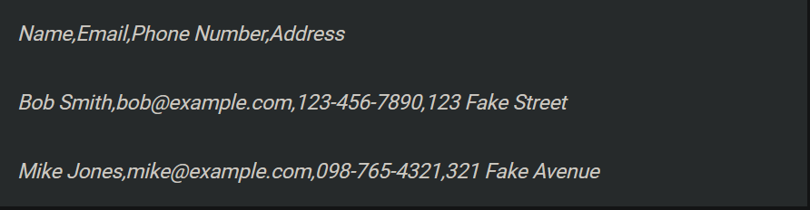
What Is A CSV File ??
A Comma Separated Values (CSV) file is a plain text file that contains a list of data.They mostly use the comma character to separate (or delimit) data, but sometimes use other characters, like semicolons.A CSV file has a fairly simple structure. It's a list of data separated by commas. For example, let's say you have a few contacts in a contact manager, and you export them as a CSV file. You'd get a file containing text like this:

Slide 10
Are CSV Files Helpful ?
Because CSV files are designed to be relatively simple, they’re frequently used across a wide range of industries to transfer complicated data between applications. With CSV files, it’s possible to export complicated data from one application to a CSV format, and then import that exported CSV data into another application where it can be used.
Another one of the most common CSV file use cases is for uploading a list of contacts into an application. This can be used to send marketing campaigns through an email delivery platform like SendGrid, or synching customer information into a CRM like Salesforce.

Slide 11
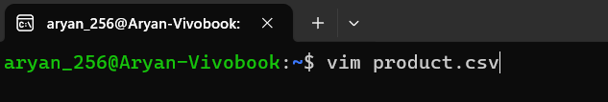
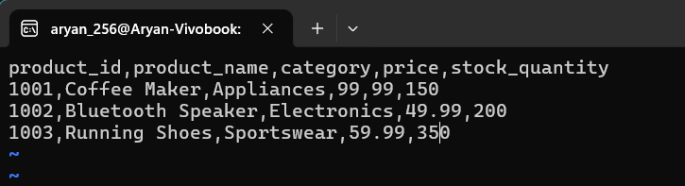
Creating a CSV File
Step 1: Open vim text editor.This is where we will write the contents of our csv file.(We name it product.csv)
Step 2: In the first line we need to define the headings.It will indicate what kind of data is mentioned after every comma in the proceeding lines.
Step 3:Write the information corresponding to its header separated by commas.

Slide 12
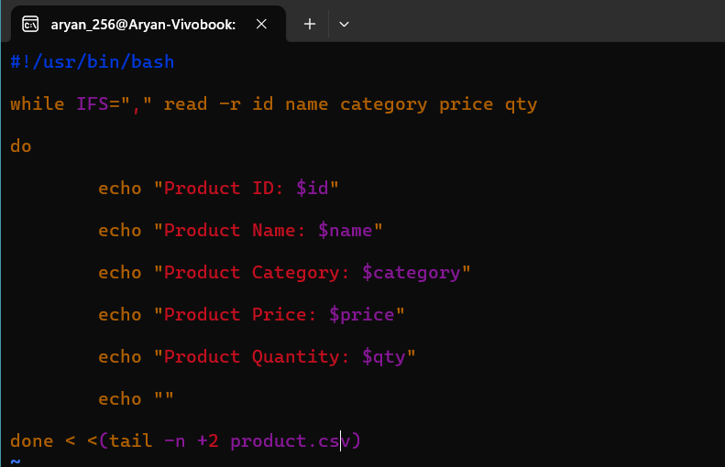
CORRESPONDING BASH SCRIPT

Slide 13

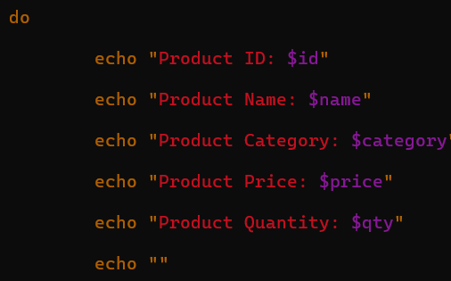
Breaking down the Code
1-We're using a while loop.The body of the loop is quite simple. A collection of echo statements are used to print the values of some variables to the terminal window.
2- In the condition of while loop we specify that a comma should be used as the internal field separator, with the IFS="," statement. The read command refers to its value when parsing sequences of text.We're using the read command's -r (retain backslashes) option to ignore any backslashes that may be in the data. They'll be treated as regular characters.

Slide 14

Breaking down the Code
3-The text that the read command parses is stored in a set of variables named after the CSV fields.
4-The data is obtained as the output from the tail command. We're using tail because it gives us a simple way to skip over the header line of the CSV file. The -n +2 (line number) option tells tail to start reading at line number two.

Slide 15
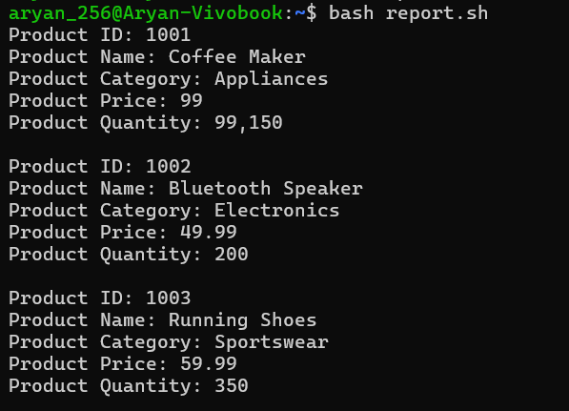
GENERATED REPORT

Slide 16
Selecting Fields
Quite often we find that they are certain data sets or information in every record that is not useful/relevant to us.It becomes necessary to remove these fields before we generate our final report.
We can obtain a selection of fields by incorporating the cut command.By adding the cut command, we're able to select the fields we want and ignore the ones we don't.

Slide 17
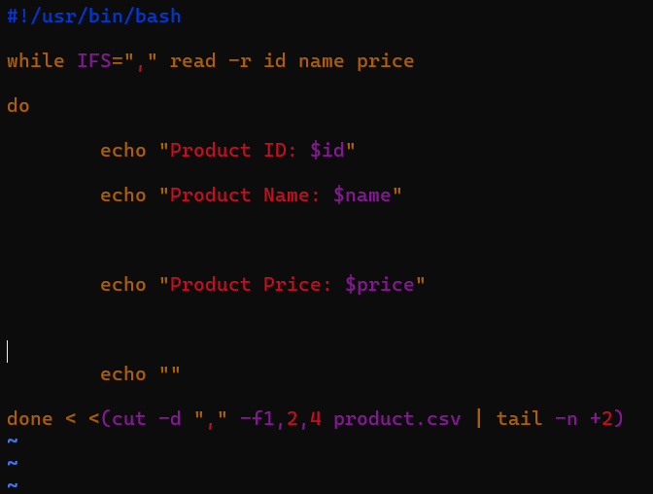
Script For Reading Selected Fields

Slide 18

Analysing the Code
We've added the cut command into the process substitution clause. We're using the -d (delimiter) option to tell cut to use commas "," as the delimiter. The -f (field) option tells cut we want fields one, four, six, and seven. Those four fields are read into four variables, which get printed in the body of the while loop.

Slide 19
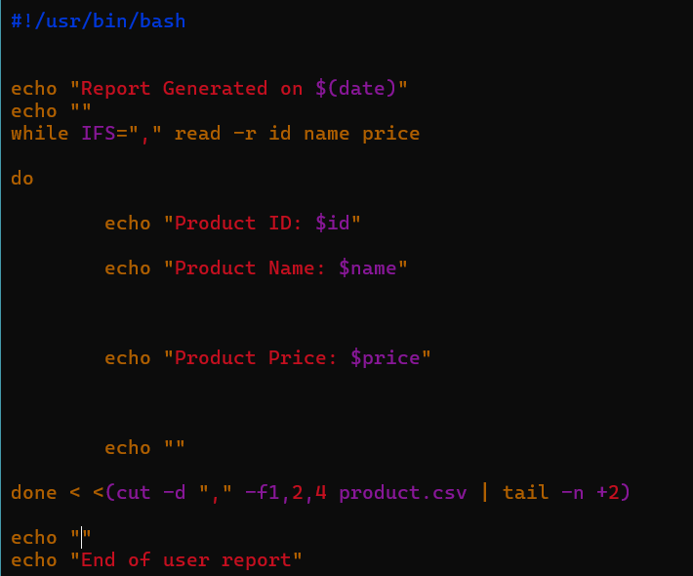
Final Script(Including Time)

Slide 20
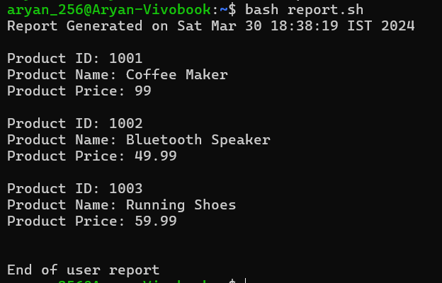
Final Report(Including Time)

Slide 21
Conclusion
These were a few of the basic ways we can generate a report by parsing a simple CSV file.Although commands and script used here is elementary, complicated CSV scripts which involve commas and double quotation within fields require a little bit more complex script.Due to the time boundation i was not able to reach till there.But the scipts i have presented suffice most of the simple csv files.
It was an interesting oppurtunity to explore a new (command) language.Notably it has many similarities to C in terms of concept like loops,variable,functions,arrays etc.I hope to explore bash more under the guidance of friends and seniors with similar interest.

Slide 22
THANK YOU !!

